Slide 1
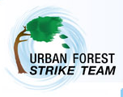
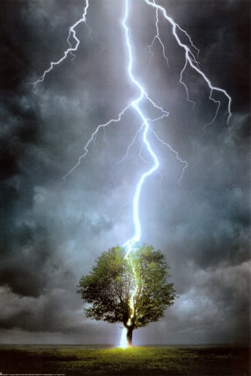
Urban Forest Strike Team Assessing Storm Damaged Trees
John Parry
U.S. Forest Service
State and Private Forestry
Durham, NH
Notes:
Collect data on species, DBH, defect, GPS coordinate, etc. Data is entered in the data dictionary on the GPS unit (see attached data dictionary for listing)collect only info needed

Slide 2
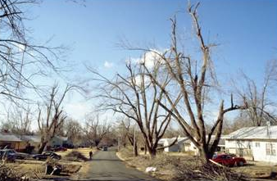
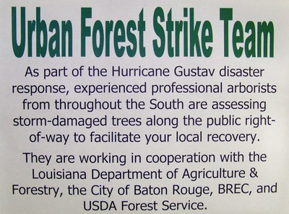
Storm Response Strike Team
Recruit & Train Tree Professionals
Deploy Crews To Disasters Areas
Crews Do Tree Assessments
Determine If Trees Stay Or Go And If Hazard Pruning Is Needed
Efficiently Plan Needed Tree Work
Document FEMA Reimbursement
Flexible – Can Be Designed To Fit Community Needs
USFS NA State and Private Forestry
Notes:
Process for Rapid Storm Assessment (Strike Team)-
Developed by USDA Forest Service, State and Private Forestry, Southern Region - Dudley Hartel
Background;
The Southern Region worked with 10 communities in the states affected by the hurricanes in 2005. They developed and refined this simple assessment process.
Using the ICS recruit, train and deploy qualified volunteers to respond to natural disaster to provide assistance. Volunteers crews used were mainly ISA or other certified arborists from around the country. This keeps municipal staff free for other tasks, and ensures professional assessment. Volunteers go through a 4 hour training.

Slide 3
Southern State Urban Forestry Programs
Paul Revell - Virginia
Leslie Moorman - North Carolina
U.S. Forest Service Urban Forestry South
Dudley Hartel
Eric Kuehler

Slide 4


Massachusetts Tree Wardens & Foresters Association Project
Cooperative Agreement to Help Introduce the Strike Team Initiative to the NE Area
Established Advisory Committee
Refine and promote the process developed in the NE area
Attended Training in Virginia, Arkansas
Conduct Training in Delaware 2011, Massachusetts in 2009
Deploy UFST Crews to
Test process after storms
USFS NA State and Private Forestry

Slide 5
4 Phases of Emergency Management
Response
Planning
Recovery
Mitigation

Slide 6
Disaster Response Timeline
Recovery Tree Work/ Planting
i-Tree Storms
Pre-
i-Tree Storms
Post-
Strike Team Assessment
12-72 hrs
3-60 days
2 – 24 months
>2 years
Disaster
Strikes
Federal
Disaster
Declaration
USFS NA State and Private Forestry

Slide 7
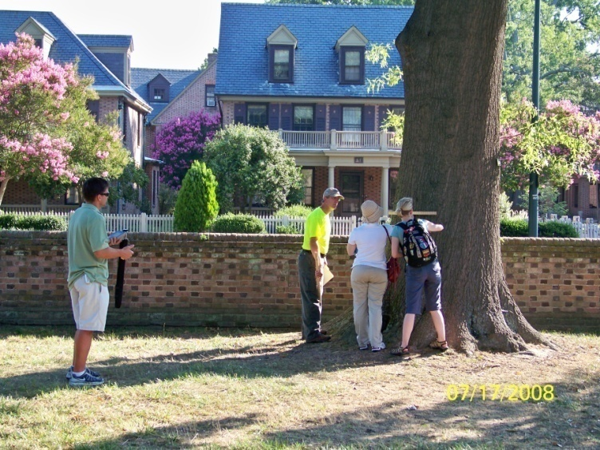
Professional Volunteers
ISA Certified
Risk Tree Experience
Strike Team Training
Take 3 NIMS On-line Courses
Willing To Assist Locally Or In Region
Reimbursed for Travel/Expenses

Slide 8
Crew Organization
Team Leader
8–12 people/Crew
7 to 14 Days
Equipment Kits
USFS NA State and Private Forestry
Notes:
Use 2 person teams with GPS units to do the inventory/storm assessment

Slide 9
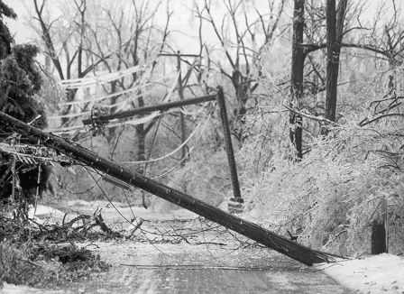
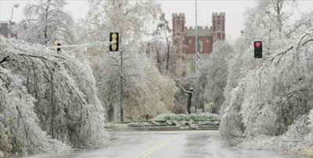
USFS NA State and Private Forestry

Slide 10
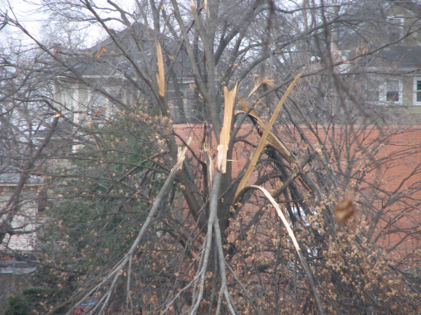
Is Strike Team Assessment Appropriate?
1. Significant Damage to Public Trees
2. Challenging to Decide on Removal and Pruning
3. Footprint of Damage is Concise
4. Community Doesn’t have Expertise or Time
5. Community Has Capacity to Follow Up ( Staff, Funds, Time)
Declared Major Disaster?
USFS NA State and Private Forestry
Notes:
Summary of Strike Team Initiative
NA has been working with the Mass. Tree Wardens and Foresters Assoc. to bring this process to the Northeast. We could bring in a crew of trained, ISA certified Arborists/Foresters to public tree inventory focused on the storm damage trees. The assessment is not intended to be part of the immediate, emergency response. It can be done weeks after the storm during the recovery stage, after the roads are cleared and urgent hazards have already been addressed.
Strike Team crews assess the remaining public trees that may need hazard tree removal or pruning based on Arboricultural and FEMA guidelines. Data is collected on GPS units, so map and data sheets can be provide regularly to the community to help them do the work needed and document damage for FEMA. Between the South and NA we have 8 GPS systems set up and ready to go. The crew can also help with other optional tasks if desired, such as marking risk trees, estimating debris on the ground, inventory of replanting spaces, etc. The assessment work would be guided by the community, the state Urban Forestry Coordinator and emergency management staff to meet their specific needs.
Some considerations in deciding if an event is a good fit for the Strike Team assessment might include the following;
1. There is significant damage to public trees in a community.
2. The damage is such that the community finds it challenging to decide what needs pruning, what needs to be removed or what can be saved. If damage is so severe that trees are blown down or broken off, there is not much need for a detailed assessment.
3. The footprint of the damage area is concise enough so that a crew could work efficiently (minor, scattered damage over a large geographic area would be better assessed in other ways such as i-Tree Storms).
4. The community may not have enough staff with technical tree expertise, or their staff may not have he time to do tree assessments.
5. The community has the capacity to use and follow up on recommendations. If they do not have staff, funds or capacity to do follow up tree work then the assessment is not as likely to be used.
6. Ideally the area is declared a disaster area so that state and/or federal assistance and funds may be available for tree work.
The Southern States and Forest Service Region started this initiative and has done a several deployments. Our Northeast Area is working with them now to introduce the process here, so we would ask them to assist. We have a small amount of funds to bring in a small crews (8 - 12 people/crew) for 1 to 2 weeks. The deployment timing would depend somewhat on the availability of the trained volunteers. We would pay for crew travel, lodging expenses, supplies, etc. but not for their salary ( this would be donated by employers).
In the northeast we have had 35 individuals who are trained, certified and willing to assist.

Slide 11
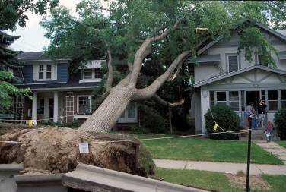
Planning for UFST Assessment
What Info Is Needed?
What Are The Time Constraints?
Know The Limits Of Resources?
Plan For Crew Logistics
What Is The Extent Of The Damage & Areas Of Prime Interest?
USFS NA State and Private Forestry
Notes:
Communities may not know what they want, so you may have to step in to let them know what they need.

Slide 12
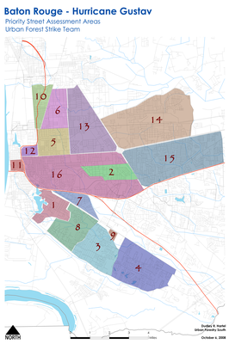
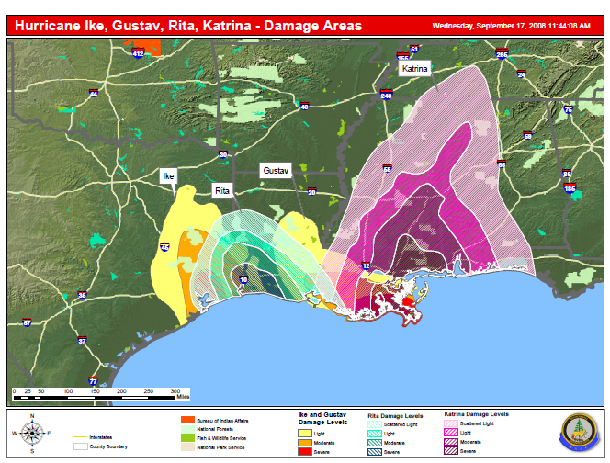
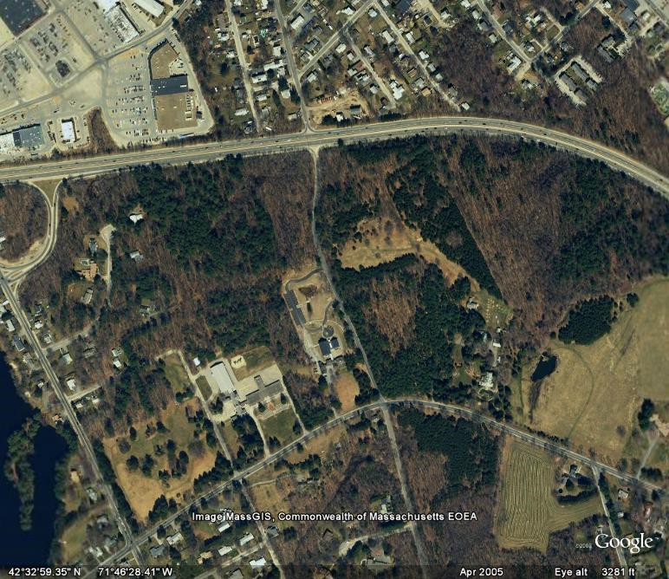
Gather Information Estimate Storm Footprint/Severity
Aerial Photos
Weather Info
Citizens Reports
Utilities
Past Inventories

Slide 13
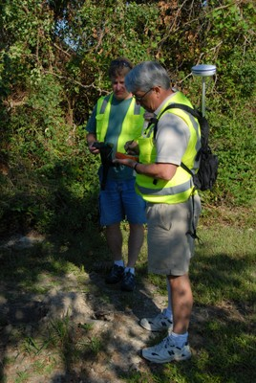
Strike Team Assessment Inventory Data
Location
Genus/Species
DBH – nearest inch
Risk Rating
Target, Size Part, Failure Probability
Recommended Action
Hazard Pruning or Removal
Meets FEMA Standards?
Public or Private?
Remarks
Other Options?

Slide 14
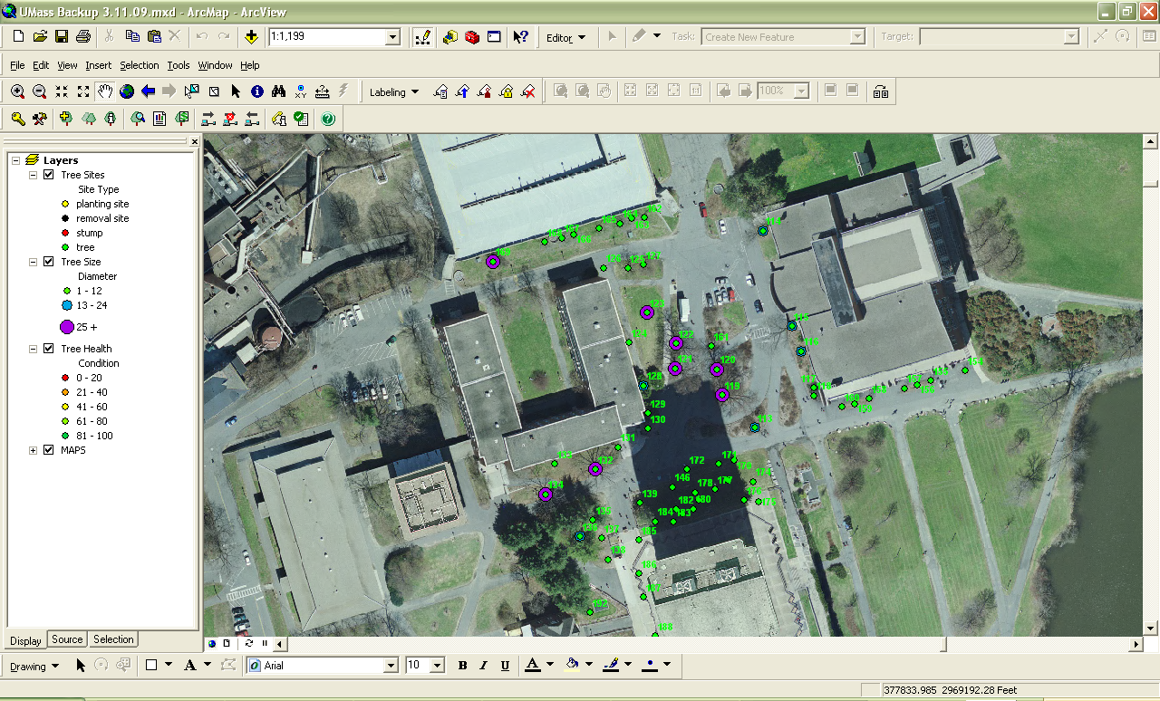
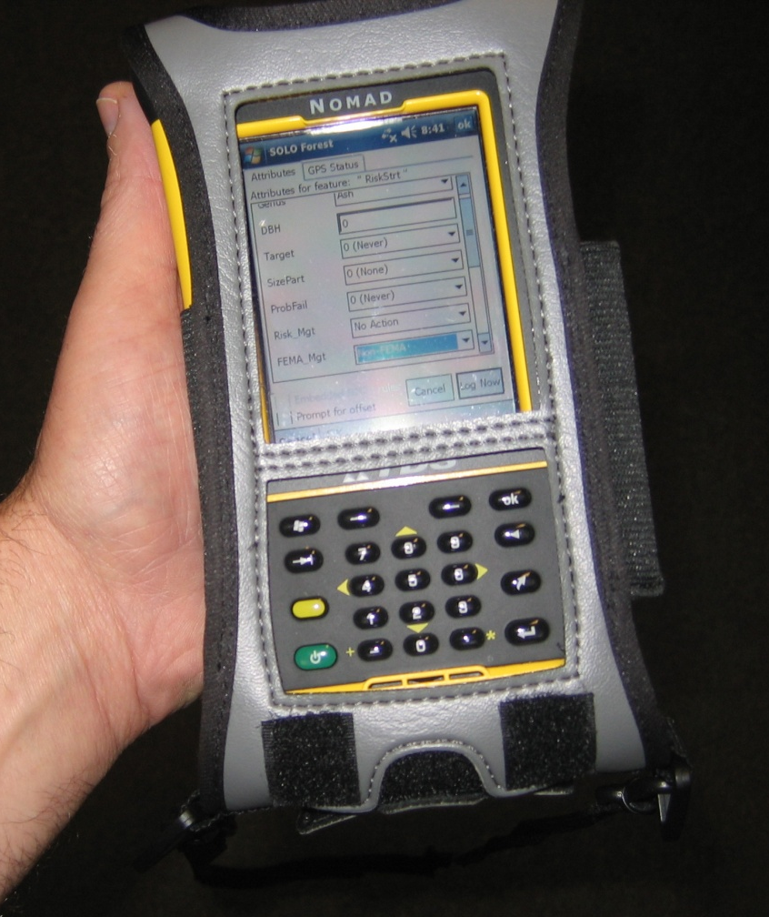
Collect Data & Locations
Using GPS

Slide 15
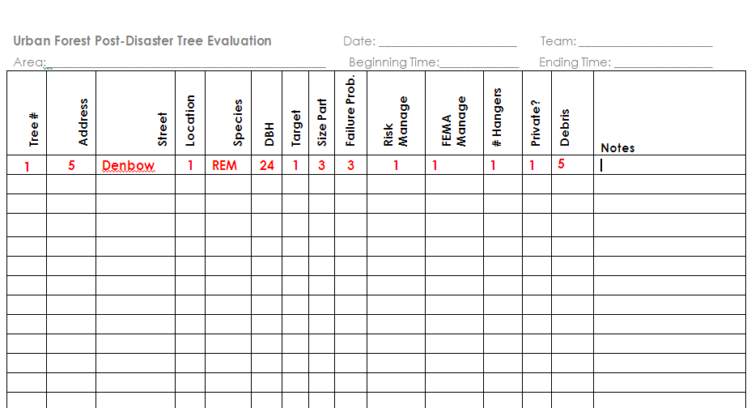
Paper Tally Sheets

Slide 16
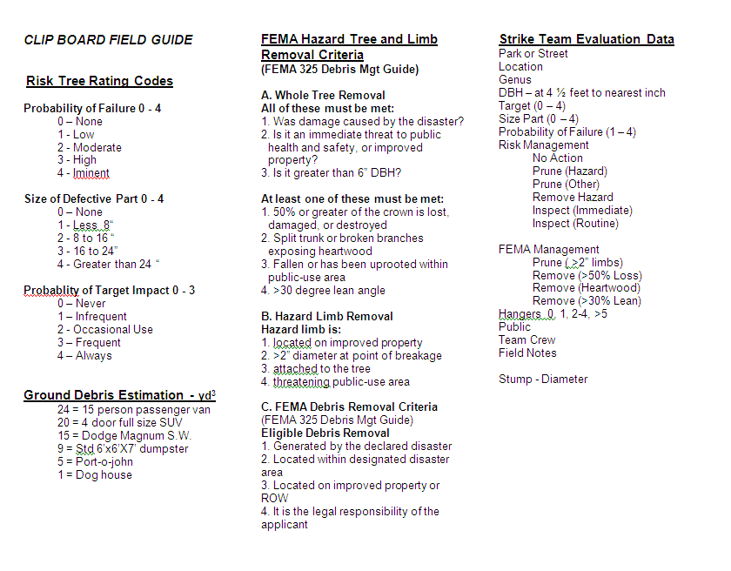

Slide 17

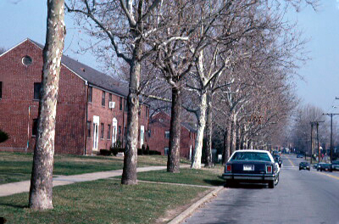
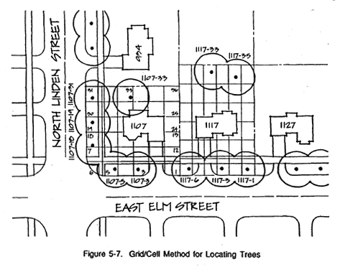
Location
GPS or Address

Slide 18
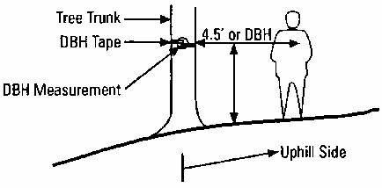

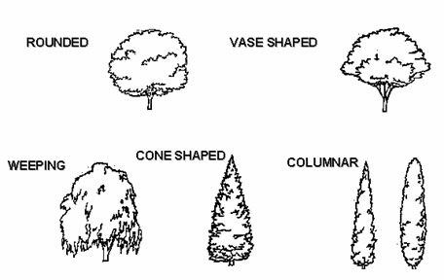
Species
DBH
USFS NA State and Private Forestry

Slide 19
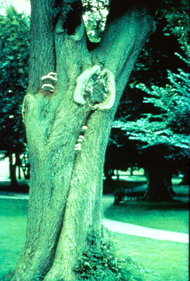
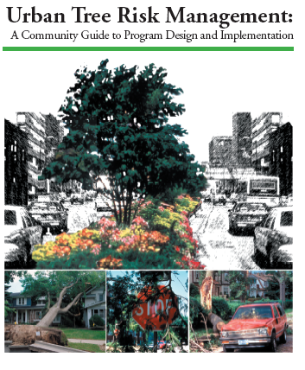
Tree Risk Rating Forest Service
Consider:
Age
Species
Site
Pre Storm Condition
Defects

Slide 20
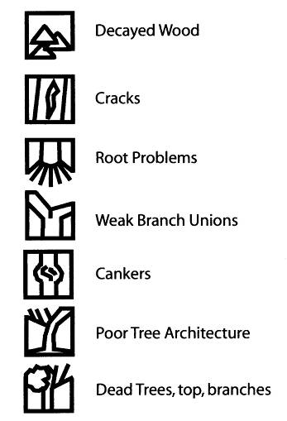
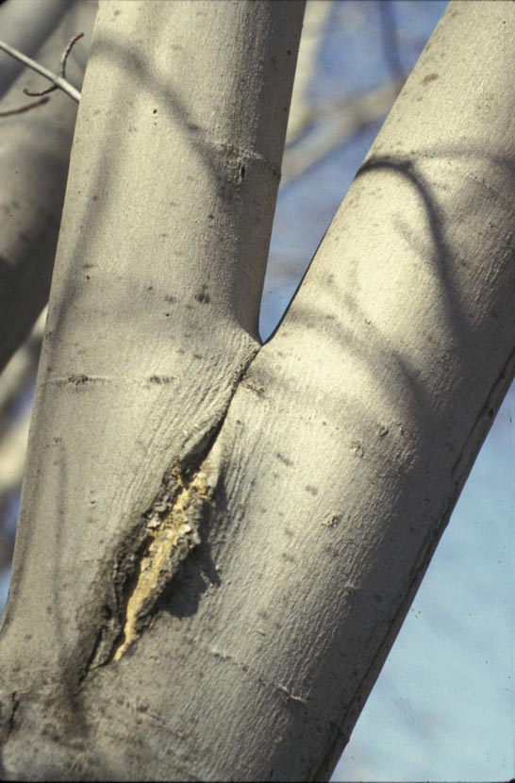
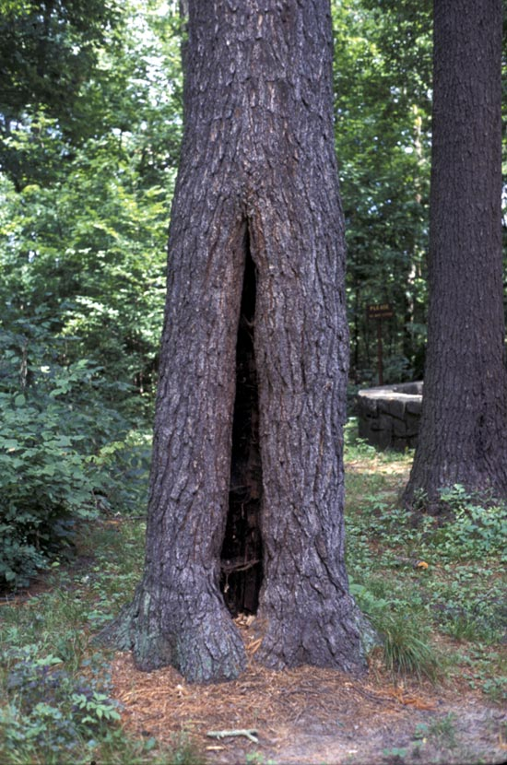
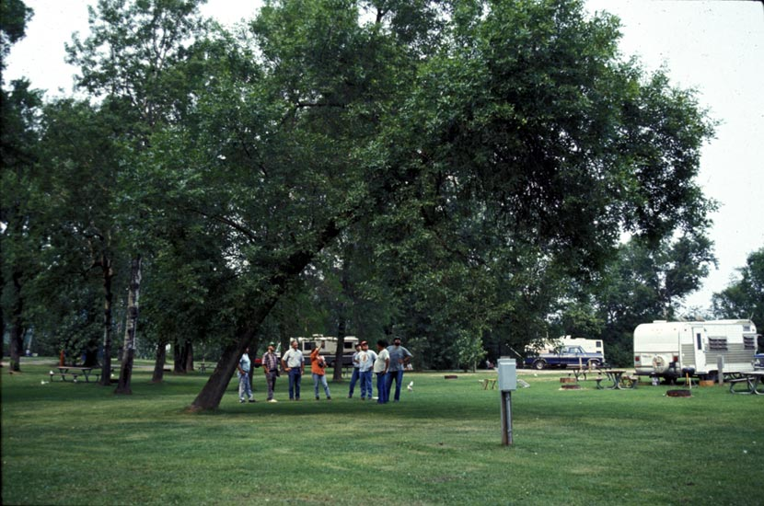
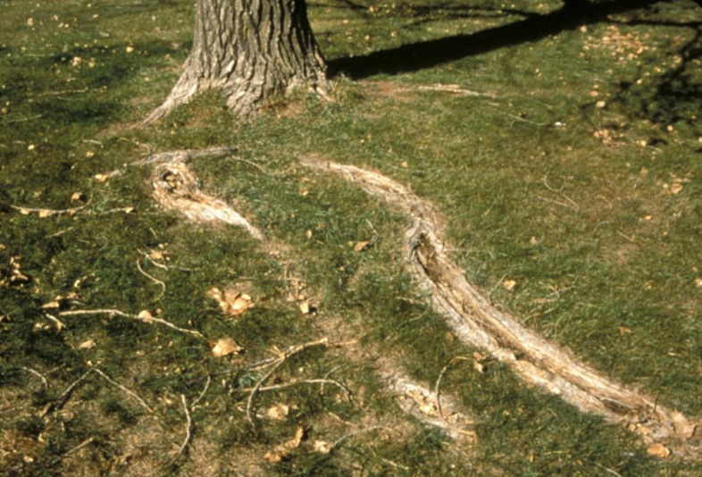
Defects

Slide 21
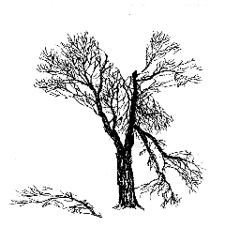
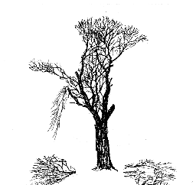
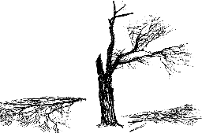
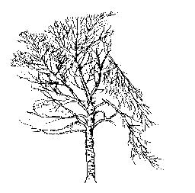
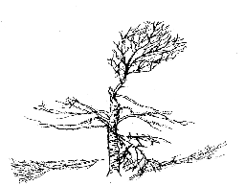
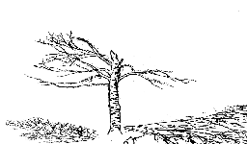
% CROWN DAMAGE vs. Survival
<50%
HIGH chance
of survival
= 50 – 75%
Survive with varying degrees
of defects
>75%
LOW chance
of survival
Maple 35%
50%
80%
Birch 40%
65%
85%
Notes:
Tree crown damage is one consideration in evaluating trees. Some trees will slow due to loss of crown. Growth in
lightly or undamaged trees on the edges of disturbed
areas may increase due to reduced competition.

Slide 22
FS: Risk Rating
0-4
Prob. of
Failure
+
0-3
Size of Part(s)
+
0-3
Prob. of Target Impact
=
0-10
Risk Rating
1 - Low
2 - Moderate
3 - High
4 - Imminent
1 - < 4“
2 - 4 to 20 “
3 - > 20 “
1 – Infrequent
2 - Occasional Use
3 – Frequent
Notes:
22
Size of defective part can be tricky when multiple defects are present. One way to “choose” from multiple defects is to select the one that you predict will fail first or will fail before the next scheduled inspection.
Probability of target impact is quite variable and the source of much discussion. A DOT agency in NY may have a unique set of definitions compared to a urban Parks Dept in NH. That’s OK! Make it work for you.

Slide 23
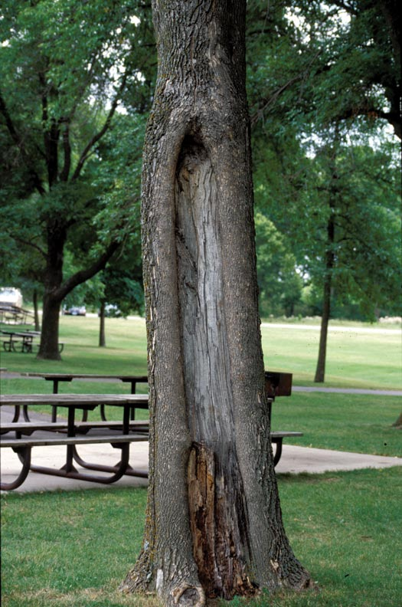
Probability of Failure
4
crack with extensive decay and cavity
outer shell width below shell safety limits (min. ratio: 2”: 6” stem diameter)
Size of Defective Part
3
greater than 20” in diameter
Probability of Target Impact
2
high-use area
Risk Rating
9
Notes:
Focus on the part of the tree that you think will fail first. Picture how the tree will fail there. Will it uproot? Will it snap off. Will a co-dominant stem pull out? Will a dead branch break off during gusty winds?
Once you have that visualized, complete the rating.
Make sure the defects match up with probability of failure category you select.
Outer shell width refers to the amount of sound wood compared to decayed wood.

Slide 24
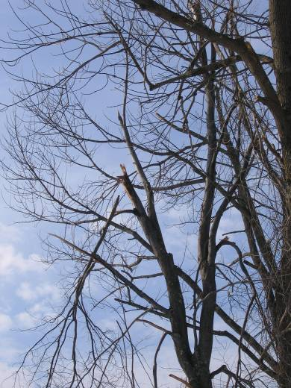
Hazard Limbs
Remove broken, hanging stems so that branches do not fall and cause injury.
USFS NA State and Private Forestry
Notes:
The purpose of canopy cleaning is to remove potential hazards like large dead branches and broken limbs. Cleaning also makes smooth pruning cuts behind broken branch stubs, which allows new growth to close over wounds. Most importantly, the least amount of live wood possible should be removed because the tree is stressed and needs to access energy stored in the limbs to recover. The food stored in the limbs is necessary for the tree to sprout, produce new leaves, and defend itself against organisms that cause decay. Do not do perform major pruning to alter the canopy shape. It is better to leave the tree looking unbalanced and misshapen than to remove large portions of the live canopy. Shaping can be done later as part of the restoration process. For safety purposes, get the hanging branches out of the way first, starting at the top of the canopy. This will prevent injuries caused by branches falling on tree workers below. The red dotted lines indicate where to make the cut. On the large, main branches there are often smaller side limbs located closer to the trunk known as laterals. A lateral is a branch arising from a larger stem. Ideally, the lateral branch should be at least 1/3 of the size of the main stem, and the lateral will preferably grow to replace the broken tip.
After the canopy of the tree has been cleaned, these are the objectives for the time before the next visit. The sight of a storm damaged tree is discouraging – often the tree appears dead – and it is during this time that one will need the most patience to wait and see whether the tree begins to sprout; many trees will.

Slide 25
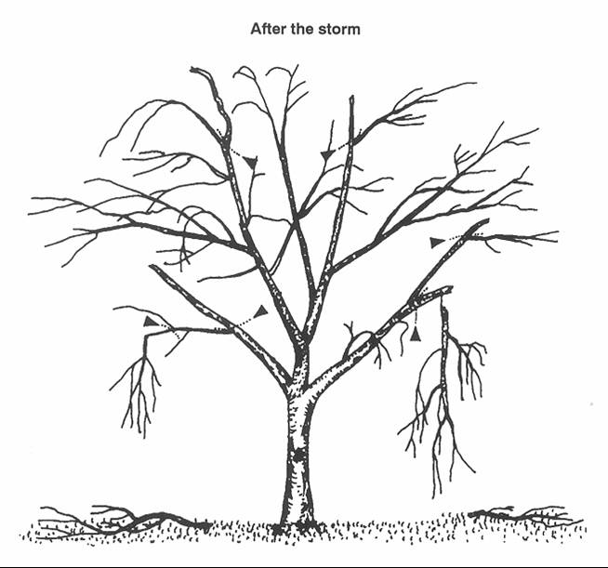
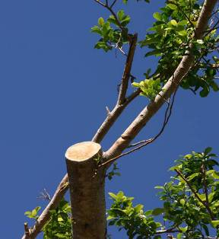
Hazard Limbs
Make clean cuts on stubs, breaks, and tears.
Reduce back to lateral branch if one is present.
USFS NA State and Private Forestry
Notes:
The picture on the bottom right is a good example of pruning back to a lateral branch. You can see that the diameter of the lateral is about 1/3 the size of the main stem where the broken stub was removed. After a storm, there will be many stubs left by branches that broke from the tree canopy. Prune back to a lateral if one is present. If the bark has torn, try to prune below the point of the tear to allow the wound to seal over properly. With larger tears, this may not be the best choice if too much of the limb will have to be reduced.

Slide 26
Risk Management
0 – No Action
1 – Prune (Hazard)
2 – Prune (Other)
3 – Remove Hazard
4 - Inspect
USFS NA State and Private Forestry

Slide 27
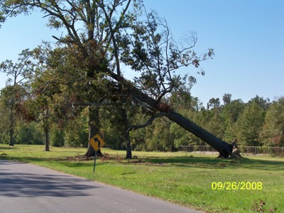
FEMA Standards Hazard Tree Removal
ALL MUST BE MET
Located In Declared Disaster Area
Entity Is Eligible Applicant
Work Is Responsibility Of Applicant
Damage Caused By The Disaster
Immediate Threat To Public
Located On Improved Public Property Or ROW
On Private Property Impacting Public ROW May Be Eligible
Tree Greater Than 6” DBH

Slide 28
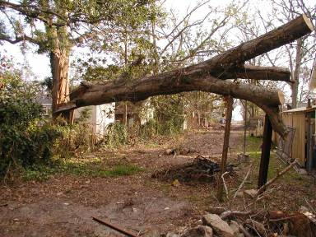
FEMA Standards Hazard Tree Removal
AT LEAST ONE MET:
>50% crown loss, damaged, destroyed
Split trunk/broken branches exposing heartwood
Fallen or has been uprooted
>30 degree lean angle
(Cabling & Bracing instead of removal?)

Slide 29
FEMA Hazard Limb Removal
>2” Diameter At Break
Hanging In Tree Attached
Hanging Unattached?
Minimal Work to Remove Hazard
# Hangers 0, 1, 2-4, >5
Notes:
Drive and/or walk streets and identify risk trees that need removal or risk trees that need pruning.
Assess in two ways
FEMAa Guidelines,
Accepted Arboricultutal Guidelines

Slide 30
FEMA Standards
Debris
On Public Property Or Row
Some Allowance for Debris On Private Property
Immediate Threat To Life, Safety And Property
Stumps
> 24” & 50% exposed ball
< 24” set cost for removal
Tree Planting – Not eligible

Slide 31
FEMA Management
1 – Prune (> 2”)
2 – Remove (> 50% Crown Loss)
3 – Remove (Heartwood)
4 – Remove (> 30% Lean)
# Hangers
Private Property
USFS NA State and Private Forestry

Slide 32
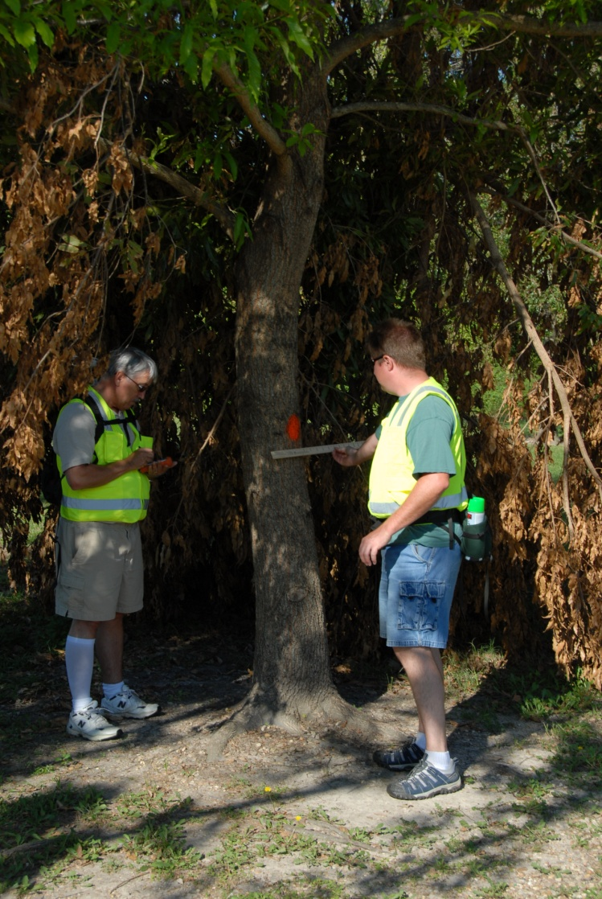
Optional UFST Activities
Trees marked
Red = Hazard Prune
Blue = Hazard Removal
USFS NA State and Private Forestry

Slide 33
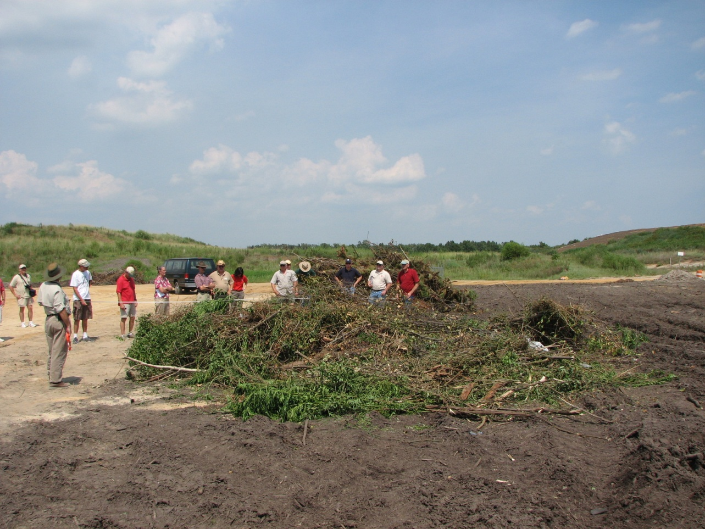
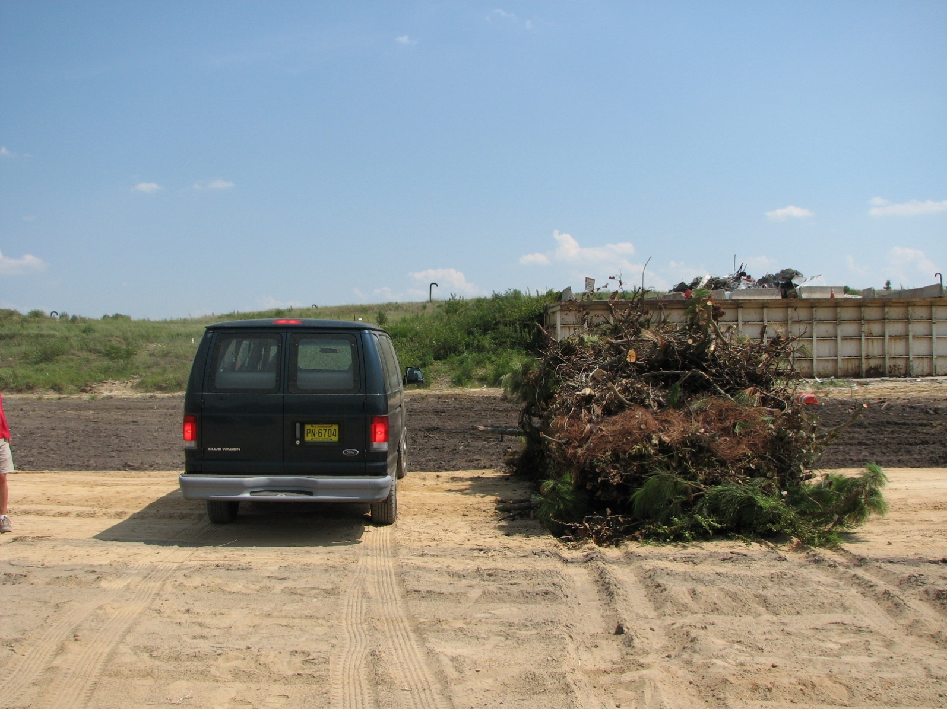
Debris Estimation
Debris Estimation
yd³
24 = 15 person van
20 = 4 door full size SUV
15 = Dodge Magnum S.W.
9 = std 6’x6’X7’ dumpster
5 = port-o-john
1 = dog house
Consult Whole Tree Volume tables for wind-thrown trees
24 cubic yards of debris
Notes:
Examples of debris estimation.

Slide 34
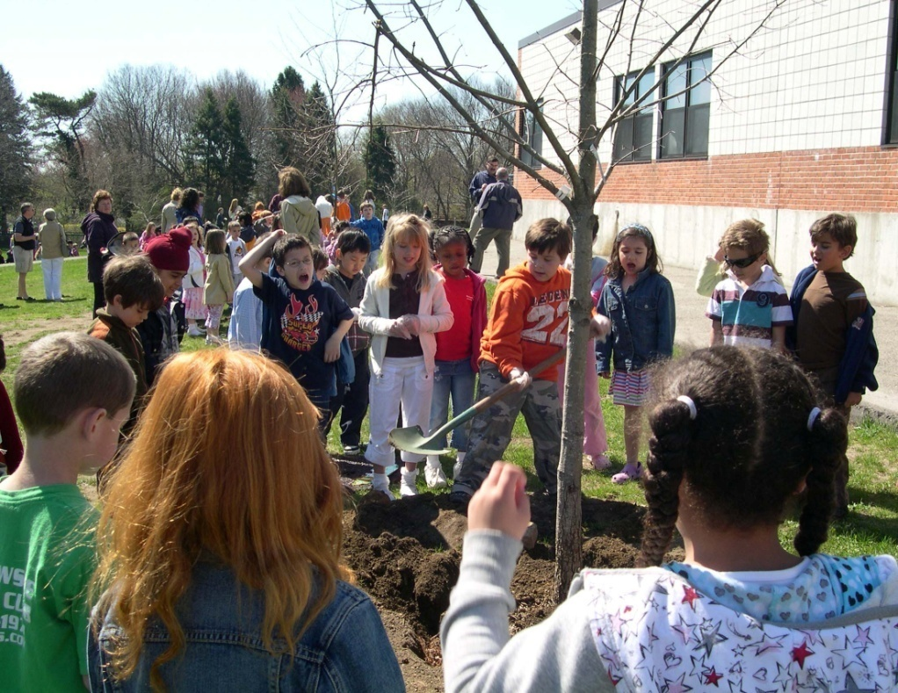
Inventory Available Tree Planting Spaces
Obtain Town Tree Planting Standards
Width Of Planting Space?
Utilities Present?
Tree Type Recommendation
USFS NA State and Private Forestry

Slide 35
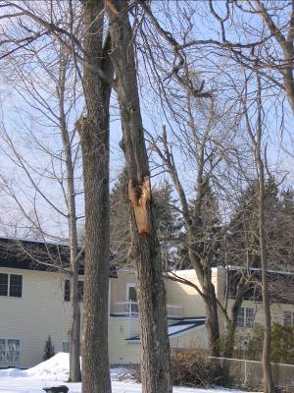
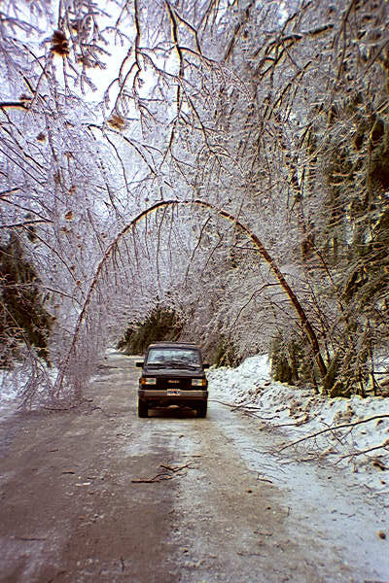
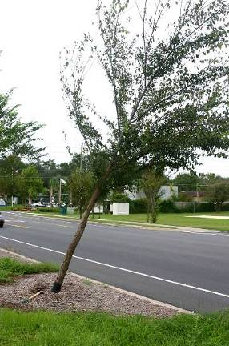
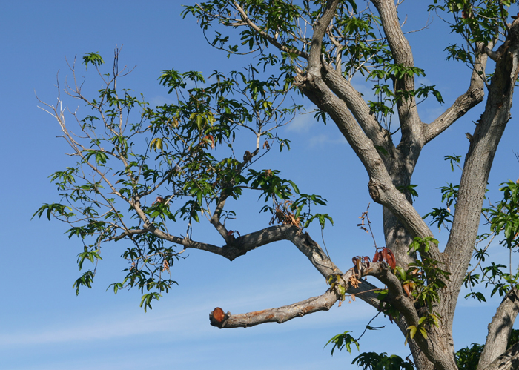
Other Tree Work Needed
Corrective Pruning
Wound Repair
Bent Trees
Replant Uprooted Trees

Slide 36
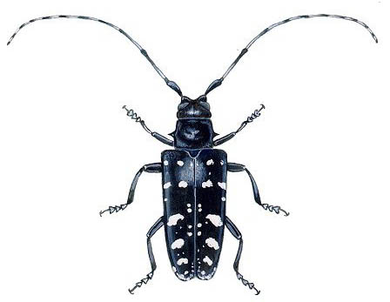
Look for Invasive Insect Signs and Symptoms
Shiny black body
White or
yellowish spots
¾ - 1¼ inches long
USFS NA State and Private Forestry
Notes:
ALB adults are relatively easy to identify. First of all they are big and “showy”. From an artistic standpoint they are nice looking insects. Once an insect reaches the adult stage they don’t get any bigger BUT like any species (and I specifically include humans) – you know that some are bigger than others. ALB adults will vary in size from ¾ inch to 1 ¼ (or even slightly larger) [not including the antennae]. The overall color is black. White spots are prevalent and if you look carefully at the antennae – at the front of the body – you will see a very distinct banding of white and black – all the way to the tip. I have an adult beetle with me and will pass it around for people to see. PASS THE ADULT ALB AROUND. There are other insects that look similar to ALB but please don’t hesitate to collect them for identification.

Slide 37
Picture with GPS Location

Slide 38
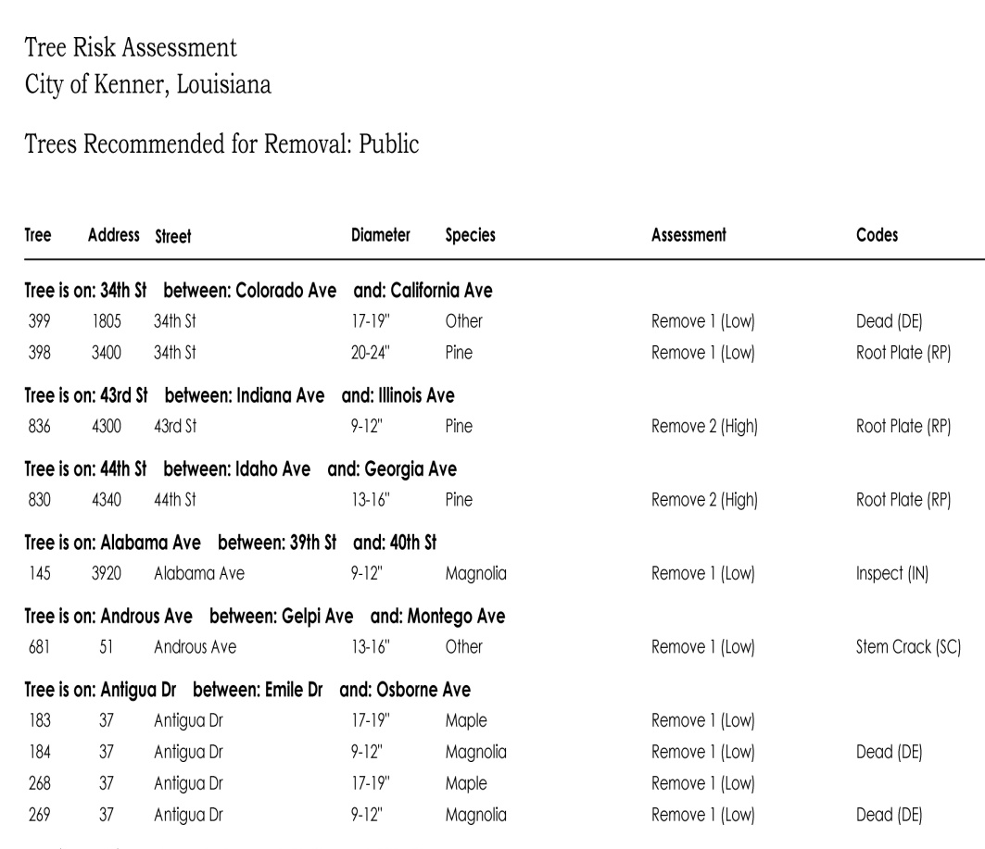

Summarizing/Reporting
How Does The City Want It?
Block Report
Priority Lists
Location Maps
Gis Layers?
USFS NA State and Private Forestry

Slide 39

Reporting Oklahoma Ice Storm

Slide 40

Notes:
After a natural disaster, municipalities are overwhelmed with trying to get services
restored to its citizens. UF professionals (if the city has any) may be stretched so
thin that they may not be able to assess trees and/or tree debris accurately or
efficiently. Communities that do not have UF professionals do not know what to do
after a storm or how to do it. This training session focuses on how you can use
existing tools to quickly and relatively accurately quantify a community’s vegetative
debris so that they can better prepare for storm clean-up, debris storage, and
possibly FEMA reimbursement.
After a storm, municipalities will have a lot of debris to deal with. They will want to
estimate the amount they have so that they can plan for its storage, and they need
to know how much it will cost them to clean it up.

Slide 41
Data Analysis

Slide 42

5 Denbow 1 SUM 26 2 3 4 3 3 1 2
USFS NA State and Private Forestry
Notes:
The purpose of canopy cleaning is to remove potential hazards like large dead branches and broken limbs. Cleaning also makes smooth pruning cuts behind broken branch stubs, which allows new growth to close over wounds. Most importantly, the least amount of live wood possible should be removed because the tree is stressed and needs to access energy stored in the limbs to recover. The food stored in the limbs is necessary for the tree to sprout, produce new leaves, and defend itself against organisms that cause decay. Do not do perform major pruning to alter the canopy shape. It is better to leave the tree looking unbalanced and misshapen than to remove large portions of the live canopy. Shaping can be done later as part of the restoration process. For safety purposes, get the hanging branches out of the way first, starting at the top of the canopy. This will prevent injuries caused by branches falling on tree workers below. The red dotted lines indicate where to make the cut. On the large, main branches there are often smaller side limbs located closer to the trunk known as laterals. A lateral is a branch arising from a larger stem. Ideally, the lateral branch should be at least 1/3 of the size of the main stem, and the lateral will preferably grow to replace the broken tip.
After the canopy of the tree has been cleaned, these are the objectives for the time before the next visit. The sight of a storm damaged tree is discouraging – often the tree appears dead – and it is during this time that one will need the most patience to wait and see whether the tree begins to sprout; many trees will.

Slide 43
USFS NA State and Private Forestry
Notes:
The purpose of canopy cleaning is to remove potential hazards like large dead branches and broken limbs. Cleaning also makes smooth pruning cuts behind broken branch stubs, which allows new growth to close over wounds. Most importantly, the least amount of live wood possible should be removed because the tree is stressed and needs to access energy stored in the limbs to recover. The food stored in the limbs is necessary for the tree to sprout, produce new leaves, and defend itself against organisms that cause decay. Do not do perform major pruning to alter the canopy shape. It is better to leave the tree looking unbalanced and misshapen than to remove large portions of the live canopy. Shaping can be done later as part of the restoration process. For safety purposes, get the hanging branches out of the way first, starting at the top of the canopy. This will prevent injuries caused by branches falling on tree workers below. The red dotted lines indicate where to make the cut. On the large, main branches there are often smaller side limbs located closer to the trunk known as laterals. A lateral is a branch arising from a larger stem. Ideally, the lateral branch should be at least 1/3 of the size of the main stem, and the lateral will preferably grow to replace the broken tip.
After the canopy of the tree has been cleaned, these are the objectives for the time before the next visit. The sight of a storm damaged tree is discouraging – often the tree appears dead – and it is during this time that one will need the most patience to wait and see whether the tree begins to sprout; many trees will.

Slide 44
USFS NA State and Private Forestry
Notes:
The purpose of canopy cleaning is to remove potential hazards like large dead branches and broken limbs. Cleaning also makes smooth pruning cuts behind broken branch stubs, which allows new growth to close over wounds. Most importantly, the least amount of live wood possible should be removed because the tree is stressed and needs to access energy stored in the limbs to recover. The food stored in the limbs is necessary for the tree to sprout, produce new leaves, and defend itself against organisms that cause decay. Do not do perform major pruning to alter the canopy shape. It is better to leave the tree looking unbalanced and misshapen than to remove large portions of the live canopy. Shaping can be done later as part of the restoration process. For safety purposes, get the hanging branches out of the way first, starting at the top of the canopy. This will prevent injuries caused by branches falling on tree workers below. The red dotted lines indicate where to make the cut. On the large, main branches there are often smaller side limbs located closer to the trunk known as laterals. A lateral is a branch arising from a larger stem. Ideally, the lateral branch should be at least 1/3 of the size of the main stem, and the lateral will preferably grow to replace the broken tip.
After the canopy of the tree has been cleaned, these are the objectives for the time before the next visit. The sight of a storm damaged tree is discouraging – often the tree appears dead – and it is during this time that one will need the most patience to wait and see whether the tree begins to sprout; many trees will.

Slide 45

USFS NA State and Private Forestry
Notes:
The purpose of canopy cleaning is to remove potential hazards like large dead branches and broken limbs. Cleaning also makes smooth pruning cuts behind broken branch stubs, which allows new growth to close over wounds. Most importantly, the least amount of live wood possible should be removed because the tree is stressed and needs to access energy stored in the limbs to recover. The food stored in the limbs is necessary for the tree to sprout, produce new leaves, and defend itself against organisms that cause decay. Do not do perform major pruning to alter the canopy shape. It is better to leave the tree looking unbalanced and misshapen than to remove large portions of the live canopy. Shaping can be done later as part of the restoration process. For safety purposes, get the hanging branches out of the way first, starting at the top of the canopy. This will prevent injuries caused by branches falling on tree workers below. The red dotted lines indicate where to make the cut. On the large, main branches there are often smaller side limbs located closer to the trunk known as laterals. A lateral is a branch arising from a larger stem. Ideally, the lateral branch should be at least 1/3 of the size of the main stem, and the lateral will preferably grow to replace the broken tip.
After the canopy of the tree has been cleaned, these are the objectives for the time before the next visit. The sight of a storm damaged tree is discouraging – often the tree appears dead – and it is during this time that one will need the most patience to wait and see whether the tree begins to sprout; many trees will.

Slide 46
USFS NA State and Private Forestry
Notes:
The purpose of canopy cleaning is to remove potential hazards like large dead branches and broken limbs. Cleaning also makes smooth pruning cuts behind broken branch stubs, which allows new growth to close over wounds. Most importantly, the least amount of live wood possible should be removed because the tree is stressed and needs to access energy stored in the limbs to recover. The food stored in the limbs is necessary for the tree to sprout, produce new leaves, and defend itself against organisms that cause decay. Do not do perform major pruning to alter the canopy shape. It is better to leave the tree looking unbalanced and misshapen than to remove large portions of the live canopy. Shaping can be done later as part of the restoration process. For safety purposes, get the hanging branches out of the way first, starting at the top of the canopy. This will prevent injuries caused by branches falling on tree workers below. The red dotted lines indicate where to make the cut. On the large, main branches there are often smaller side limbs located closer to the trunk known as laterals. A lateral is a branch arising from a larger stem. Ideally, the lateral branch should be at least 1/3 of the size of the main stem, and the lateral will preferably grow to replace the broken tip.
After the canopy of the tree has been cleaned, these are the objectives for the time before the next visit. The sight of a storm damaged tree is discouraging – often the tree appears dead – and it is during this time that one will need the most patience to wait and see whether the tree begins to sprout; many trees will.

Slide 47

USFS NA State and Private Forestry
Notes:
The purpose of canopy cleaning is to remove potential hazards like large dead branches and broken limbs. Cleaning also makes smooth pruning cuts behind broken branch stubs, which allows new growth to close over wounds. Most importantly, the least amount of live wood possible should be removed because the tree is stressed and needs to access energy stored in the limbs to recover. The food stored in the limbs is necessary for the tree to sprout, produce new leaves, and defend itself against organisms that cause decay. Do not do perform major pruning to alter the canopy shape. It is better to leave the tree looking unbalanced and misshapen than to remove large portions of the live canopy. Shaping can be done later as part of the restoration process. For safety purposes, get the hanging branches out of the way first, starting at the top of the canopy. This will prevent injuries caused by branches falling on tree workers below. The red dotted lines indicate where to make the cut. On the large, main branches there are often smaller side limbs located closer to the trunk known as laterals. A lateral is a branch arising from a larger stem. Ideally, the lateral branch should be at least 1/3 of the size of the main stem, and the lateral will preferably grow to replace the broken tip.
After the canopy of the tree has been cleaned, these are the objectives for the time before the next visit. The sight of a storm damaged tree is discouraging – often the tree appears dead – and it is during this time that one will need the most patience to wait and see whether the tree begins to sprout; many trees will.

Slide 48

Urban Forestry Strike Team http://www.ufst.org/
USFS NA State and Private Forestry

Slide 49



Questions?
?
John E. Parry
U.S. Forest Service
State & Private Forestry
Durham, NH
603-868-7688,
jparry@fs.fed.us
www.na.fs.fed.us/urban
Urban Forestry Strike Team http://www.ufst.org
USFS NA State and Private Forestry

Slide 50





Slide 51
Risk Assessment Protocol
Basic components of data collection
Species (can be to genus)
DBH
Location (preferably spatial)
Remove entire tree or prune hazard limbs
Justification
Immediate action required
Not storm related
Notes (make it brief)

Slide 52


Slide 53


Slide 54


Slide 55
OBS: rooting area damaged ++AREA: 30% ++DIR: East
OBS: branches (<2" diameter) broken ++AFFECTS: 5 limbs/roots ++DIR: South
OBS: trunk hollow ++SHELL: 2"
OBS: limb split ++SIZE: 20%DBH ++DIR: South
-----
OBS: root plate disturbed; no significant lifting
OBS: rooting area damaged ++AREA: 20% ++DIR: Northeast
-----
OBS: numerous soil cracks within 12' of trunk
OBS: limb twisted ++SIZE: 50%DBH ++DIR: Southeast

Slide 56




Slide 57

www.na.fs.fed.us/urbanUFIND
Storms Over the Urban Forest: Planning, Responding, and Regreening—A Community Guide to Natural Disaster Relief
Trees and Ice Storms: The Development of Ice-storm Resistant Urban Tree Populations
Tree Emergency Manual for Public Officials
Tree Emergency Planning Worksheet - Worksheet
Storms Media Kit - Press releases
USFS NA State and Private Forestry

Slide 58
USFS NA State and Private Forestry
Notes:
The purpose of canopy cleaning is to remove potential hazards like large dead branches and broken limbs. Cleaning also makes smooth pruning cuts behind broken branch stubs, which allows new growth to close over wounds. Most importantly, the least amount of live wood possible should be removed because the tree is stressed and needs to access energy stored in the limbs to recover. The food stored in the limbs is necessary for the tree to sprout, produce new leaves, and defend itself against organisms that cause decay. Do not do perform major pruning to alter the canopy shape. It is better to leave the tree looking unbalanced and misshapen than to remove large portions of the live canopy. Shaping can be done later as part of the restoration process. For safety purposes, get the hanging branches out of the way first, starting at the top of the canopy. This will prevent injuries caused by branches falling on tree workers below. The red dotted lines indicate where to make the cut. On the large, main branches there are often smaller side limbs located closer to the trunk known as laterals. A lateral is a branch arising from a larger stem. Ideally, the lateral branch should be at least 1/3 of the size of the main stem, and the lateral will preferably grow to replace the broken tip.
After the canopy of the tree has been cleaned, these are the objectives for the time before the next visit. The sight of a storm damaged tree is discouraging – often the tree appears dead – and it is during this time that one will need the most patience to wait and see whether the tree begins to sprout; many trees will.

