Slide 1
i-TREE Pest Detection
On-line Training Seminar
April 19, 2011

Slide 2


Session 1 Introduction to IPED
Anne Cumming, USDA Forest Service
Scott Maco, Davey Tree Expert Company
Notes:
Introduction
Welcome to the first of four on-line training sessions dedicated to exploring “IPED” – the pest detection tool for inventories.
Our other sessions, that will be held on consecutive Tuesdays, will cover the specifics of setting up and using the pest detection tool within iTREE v4.0

Slide 3
Topics for Today
Urban Forest Health - The Big Picture
What is IPED?
The i-Tree Connection
Choosing IPED as a Resource for Your Community
Notes:
But today we are going to ease into the subject of pest detection and give some context for the training sessions to follow.

Slide 4
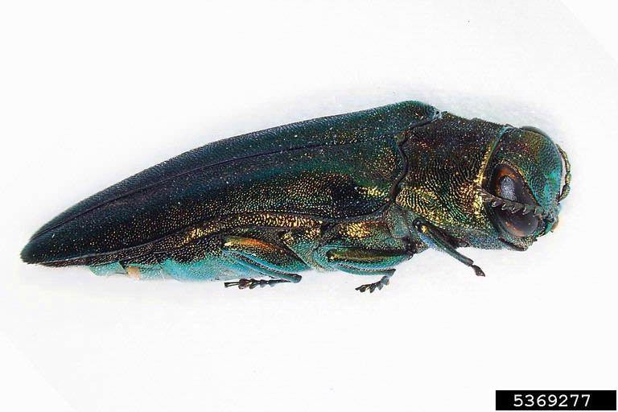
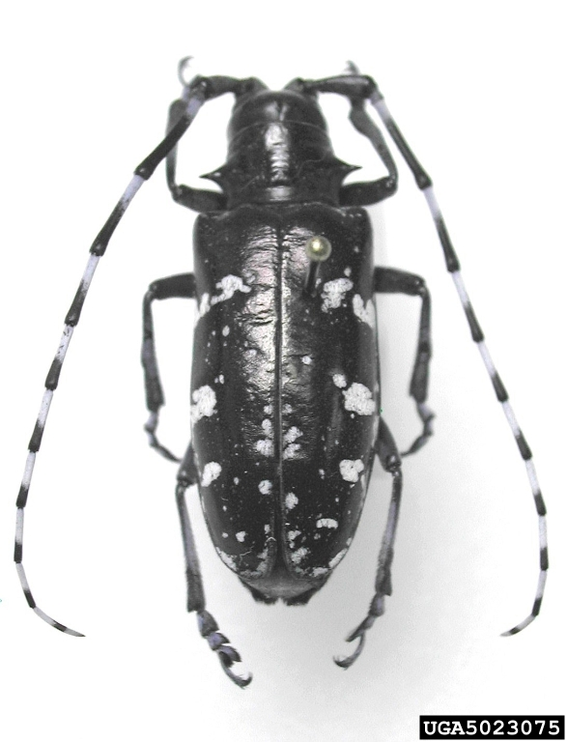
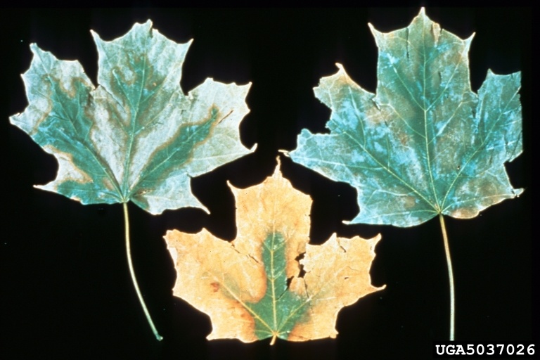
Urban Forest Health
Notes:
The concept of urban forest can cover and mean many things. In this case, we are considering all trees within communities – whether those communities are small towns or large metropolitan areas. These trees are the trees we see everyday – in parks, yards, small wood lots and along streets. Together, these trees make a forest.
The concept of forest health also can denote various ideas. To the citizen scientist or arborist, health may mean “condition” – does the tree “look” healthy? Does it look “good”? The variable “condition” is a common element that is collected during an inventory. Poor, good, fair, excellent…
To the forest pathologist or entomologist, “health” is equated with absence from disease or insect pests.

Slide 5
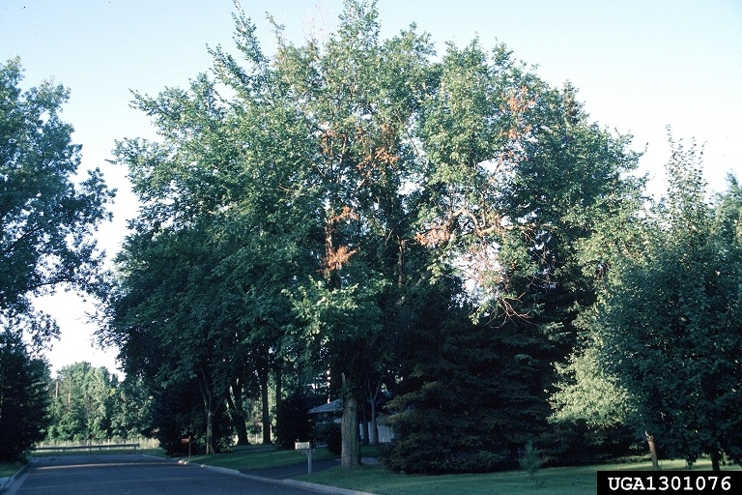
Urban Forest Health
Joseph O'Brien, USDA Forest Service, Bugwood.org
Notes:
For many years the description of a tree’s condition was sufficient. If a tree was in poor condition, the city, arborist, or homeowner would just cut it down and re-plant. Not really thinking about why. Of course there were some significant exceptions to that – like Dutch elm disease outbreak – where people were thinking more about the why’s of declining trees.
But the general descriptions of good, fair, poor excellent don’t really give us much to go on when a tree is not looking so “good”.
After the outbreaks of ALB in Chicago, NYC and the recent infestations in Worchester, MA and NJ, coupled with the massive destruction of ash by EAB in the mid-west, folks started to talk about ways to detect pests and diseases more quickly.

Slide 6
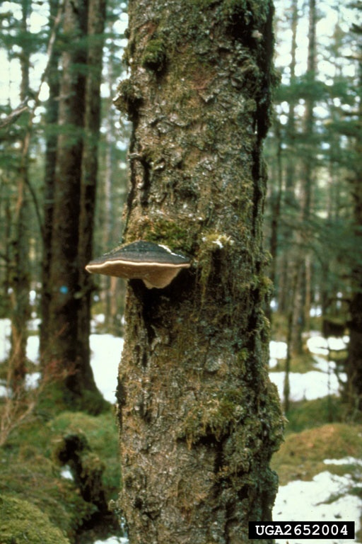
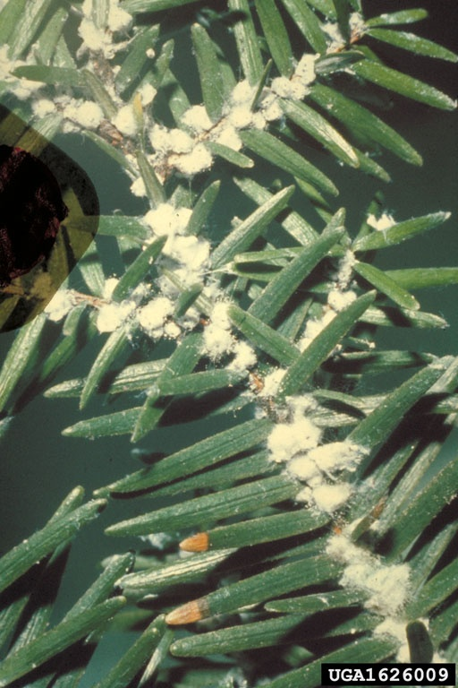
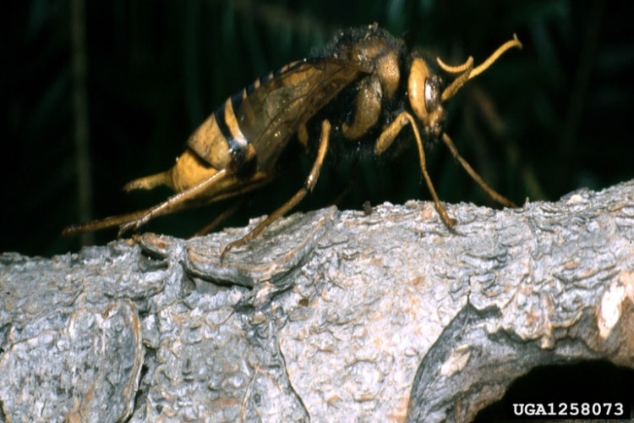
What is IPED?
Stanislaw Kinelski, , Bugwood.org
John A. Weidhass, Virginia Polytechnic Institute and State University, Bugwood.org
Tom Laurent, USDA Forest Service, Bugwood.org
Notes:
So, as a way to systematically examine a tree for signs and symptoms of pests and diseases, our group convened to construct a protocol to do just that.
Starting in 2008, we’ve been working on the protocol – “how to look at a tree” and the programming aspects of that. The result was the March 2011 release of IPED as a component of iTREE 4.0.
The program walks the user through a short series of data screens and looks at the tree from tip to base and asks about signs or symptoms of concern that might be present.
There are currently 64? pests, diseases and fungi that are included in the database.
23 Beetles/Weevils
14 Moths
11 Fungi
3 Woodwasps
2 Adelgids
3 “Other diseases” Beech bark disease, example.

Slide 7
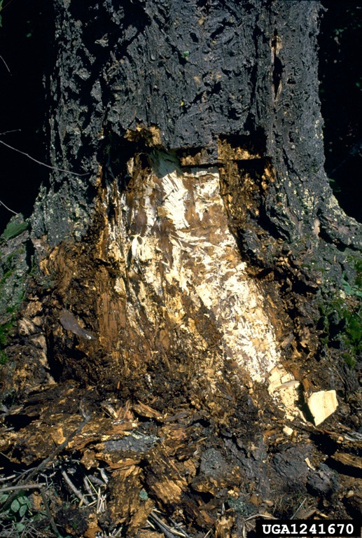
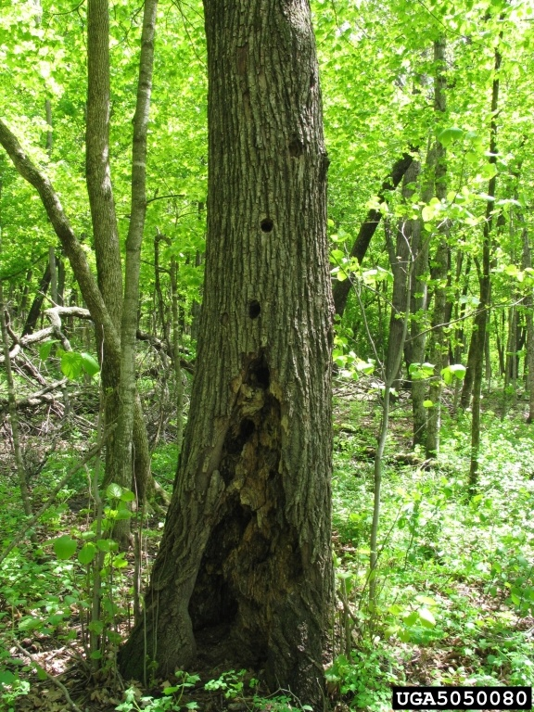
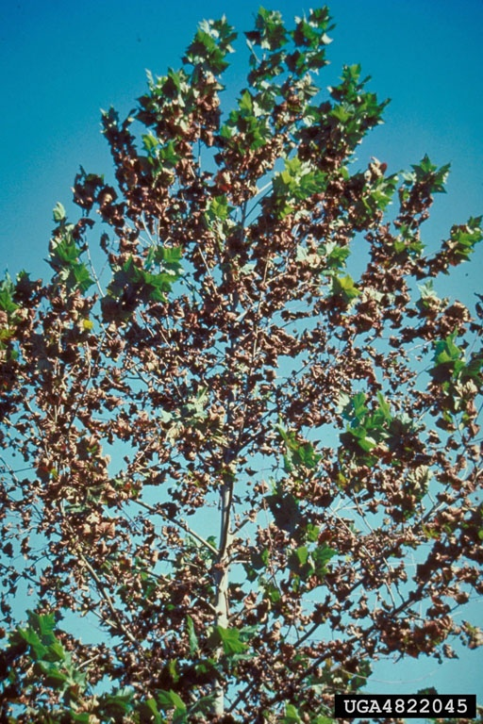
What is IPED?
Cathy Stewart, USDA Forest Service, Bugwood.org
Joseph O'Brien, USDA Forest Service, Bugwood.org
Edward L. Barnard, Florida Department of Agriculture and Consumer Services, Bugwood.org
Notes:
The basis for the protocol is the national forest health monitoring program – that is now part of the Forest Services Forest Inventory and Analysis program. By looking at specific locations on the tree for signs and symptoms of pests and diseases, the surveyor can gather meaningful information that can be compared to other trees.
Tree Stress, Bole/Trunk, and Leaves/Branches are the three areas of interest.
The protocol is available to everyone for use with their own software systems or as a stand alone with a spreadsheet. Other urban forest inventory vendors will be able to incorporate IPED into their own systems if desired.

Slide 8
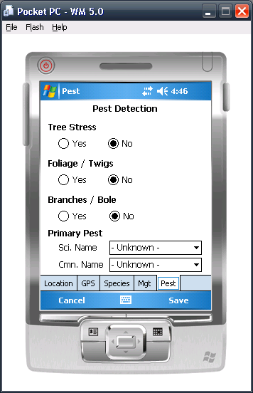
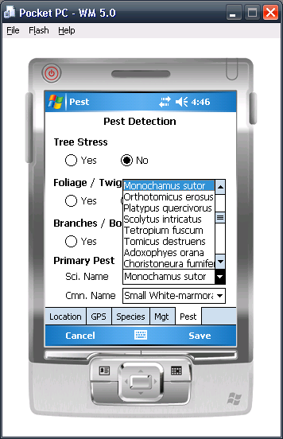
i-TREE Connection
Notes:
Although freely available to be used as a stand alone tool, IPED is also a tool that is available within i-TREE.
As you’ll recall, i-TREE is a free-ware program developed by the Forest Service, Davey Tree Expert Company, SMA, ISA and others and can be used for urban forest inventories and samples. The power of i-TREE is in its ability to provide analysis of those data – including structural values, heating and cooling, and air pollution abatement. The i-Tree Tools help communities of all sizes to strengthen their urban forest management and advocacy efforts by quantifying the structure of community trees and the environmental services that trees provide.
The pest detection protocol is a part of iTREE Streets. Soon, the protocol will be included within iTREE Eco, as well. But that is a future enhancement. This training series will focus on pest detection using iTREE Streets

Slide 9
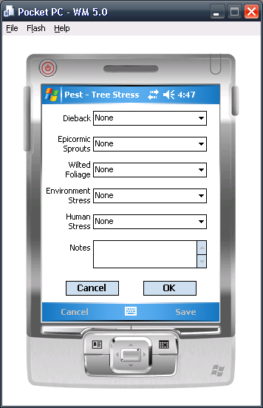
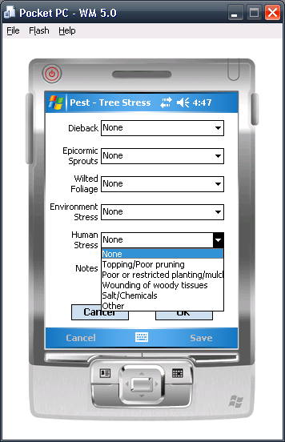
i-TREE Connection

Slide 10
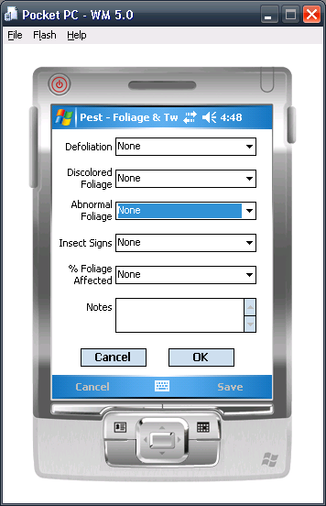
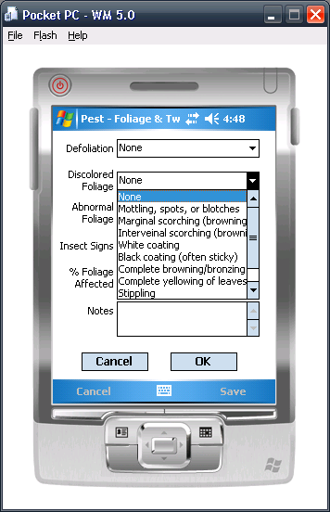
i-TREE Connection

Slide 11
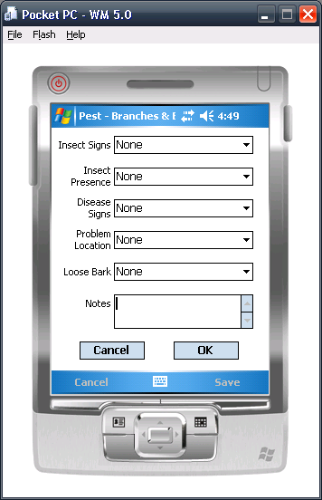
i-TREE Connection

Slide 12
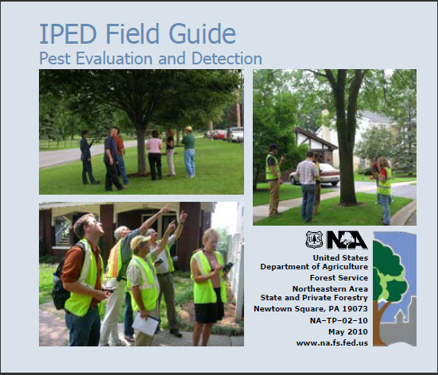
i-TREE Connection
Notes:
Finish by mentioning:
-- reporting functions – summary of the data collected
-- lucid key help – helps guide users to likely causes and possible ID of pests
-- extensive on-line help – pest fact sheets

Slide 13
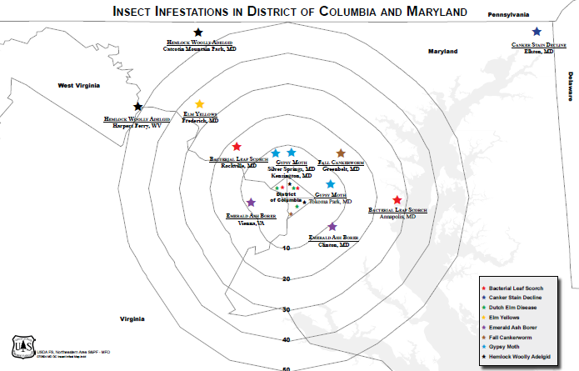
Choosing IPED for your Community
Notes:
This is a rough graphic that was produced in our office in 2007. It shows the District of Columbia in the center, concentric circles representing 10 mile intervals, and stars of different colors. The stars represent the confirmed presence of a pest, like Emerald ash borer, or disease, such as Dutch elm disease.
As much as I’ve been involved with urban forest health issues in the last decade, this graphic really resonates for me.
Forest managers, urban or not, benefit from knowing potential, but real, stresses, pressures or risks to the resource they are trying to manage.
Imagine if you had such a map for your area – whether that’s a township, small community or a whole state – identifying pressures that are within striking distance would influence how you manage the forest.

Slide 14
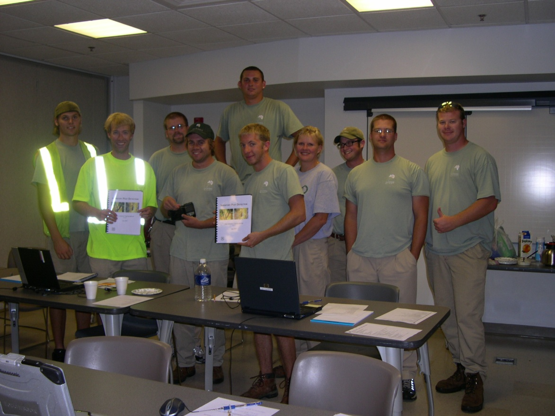
Choosing IPED for your Community
Notes:
Even within your own boundaries – not seeing data from adjacent jurisdictions – knowing areas that “not healthy”, is important for management.
Using IPED while inventorying your trees adds minimal time spent at the tree. After a bit of training, the protocol becomes routine and fairly quick.
Benefits from spending that extra time (or money if you’re contracting), out weigh the costs.
Data will be able to indicate problems long before they become catastrophic. If the folks in Worchester, MA had been able to report of these types of data fields, the ALB outbreak could have been detected years in advance.
Having a systematic way to “look” for signs and symptoms that indicate health is an advantage. Your staff or contractor may be out there looking at trees and notice things that are not “right” – but if there is no way to communicate and describe what they are looking at, those observations are lost.
Finally, IPED should be able to help with early detection of serious pests and diseases at their points of introduction. There are approximately 6000 US communities and cities that have and maintain inventories. If all those places were looking for new outbreaks, that information would be powerful – both for control and for cost savings.

Slide 15
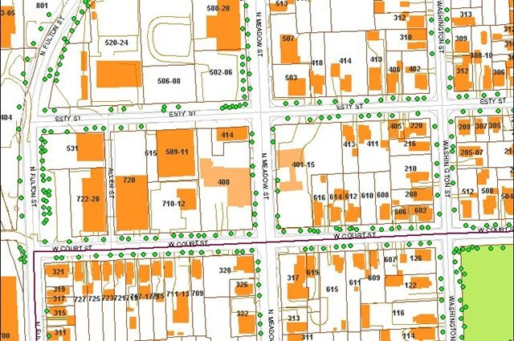
Choosing IPED for your Community
Notes:
We are still at the beginning of this journey and are eager for feedback and suggestions.
Developed with many partners, we strived for balance – collecting enough data to be useful, while trying to keep the data collection at a level where time and cost were manageable in a production setting.

Slide 16
Training Session Schedule
Week 2: Planning and Set Up
Week 3: Pest Signs and Symptoms
Week 4: Interpreting and Reporting Your Results
Notes:
At this point, I’d like to open the lines for discussion and questions.
Are there specific topics that the group would like to explore during the training sessions? Or maybe you’re not familiar enough with the program to know?

Slide 17
Session 2 Planning and Set Up
April 26, 2011
1:00 PM (Eastern)
Donna Murphy, USDA Forest Service
Joe LaForest, University of Georgia

